Slide 1
Rockbuster Stealth LLC
Justin Fehlberg
6/22/23

Slide 2
A Launch Strategy For The New Online Video Service

Slide 3

Introduction
Rockbuster Stealth LLC is a movie rental company that used to have stores around the world. Facing stiff competition from streaming services such as Netflix and Amazon Prime, the Rockbuster Stealth management team is planning to use its existing movie licenses to launch an online video rental service in order to stay competitive.

Slide 4
Key Questions and Objectives
Which movies contributed the most/least to revenue gain?
What was the average rental duration for all videos?
Which countries are Rockbuster customers based in?
Where are customers with a high lifetime value based?
Do sales figures vary between geographic regions?

Slide 5


Background information
Average Rental Duration
5 Days
Minimum Rental Duration
3 Days
Maximum Rental Duration
7 Days
Average Rental Rate
2.98
Minimum Rental Rate
.99
Maximum Rental Rate
4.99
Average Length
115.272
Minimum Length
46
Maximum Length
185
Average Replacement Cost
19.984
Minimum Replacement Cost
9.99
Maximum Replacement Cost
29.99
Most Common Title
Academy Dinosaur
Most Common Release Year
2006
Most Common Rating
2006
Total Movie Count
1000

Slide 6
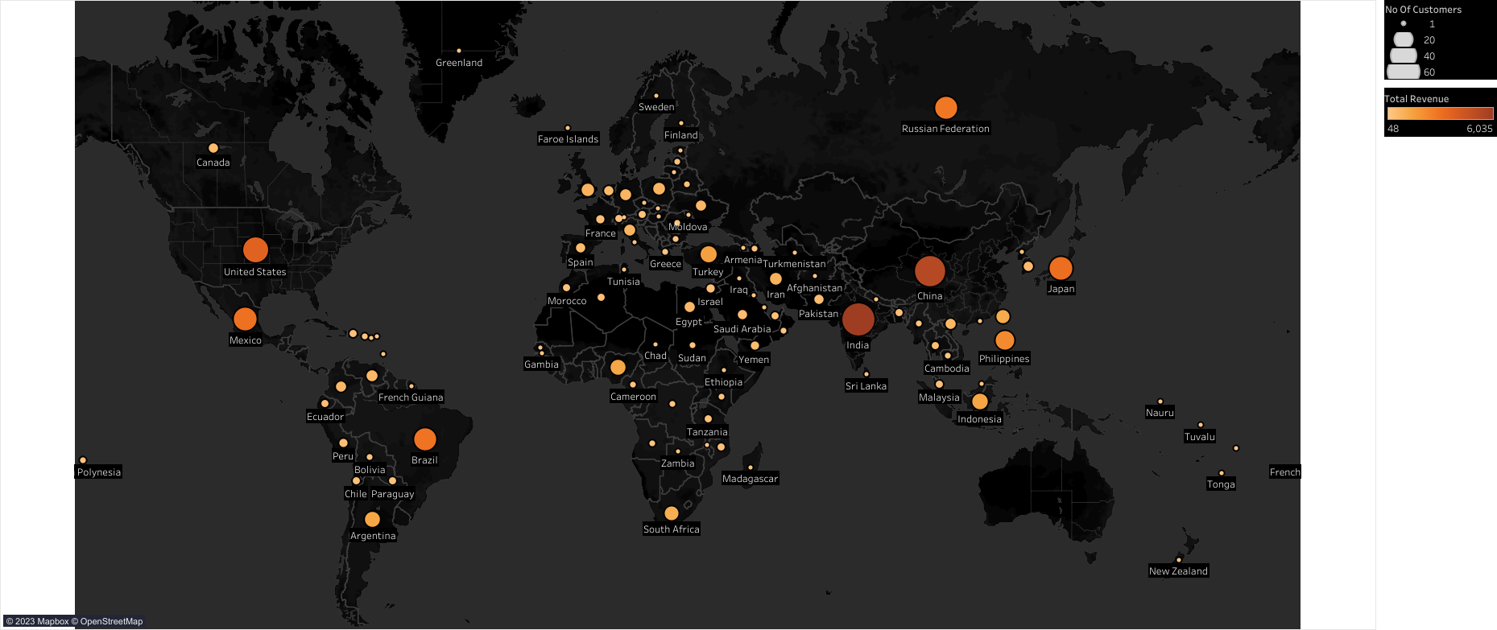
Demographics by Revenue and Customer

Slide 7
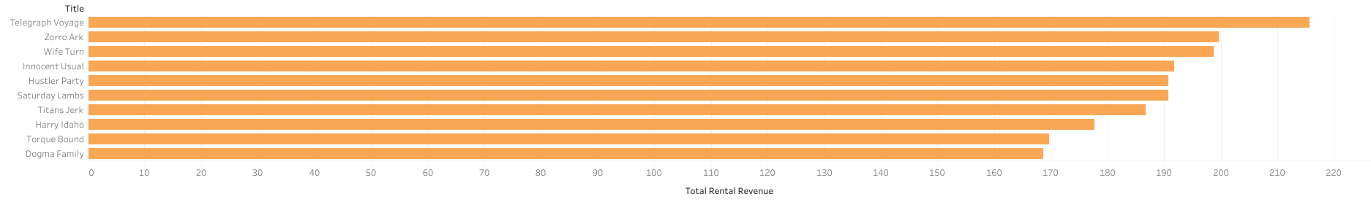
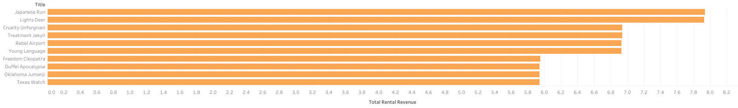
Highest and Lowest Grossing Titles
This chart depicts the top 10 film titles by total revenue. These 10 titles absolutely need to be included in the online catalogue.
This chart depicts the bottom 10 film titles by total revenue. These 10 titles can be removed from the online catalogue if necessary.

Slide 8
Customer Total Dempgraphics
country | count
India | 60
China | 53
United States | 36
Japan | 31
Mexico | 30
Brazil | 28
Russian Federation | 28
Philippines | 20
Turkey | 15
Indonesia | 14
country | city
United States | Aurora
Mexico | Acua
United States | Citrus Heights
Japan | Iwaki
India | Ambattur
China | Shanwei
Brazil | So Leopoldo
Russian Federation | Teboksary
China | Tianjin
Indonesia | Cianjur
The chart to the left depicts the top 10 cities located in the top 10 countries by customers.
The chart above depicts the top 10 countries by customer count. This shows India has the most with 60 customers and Indonesia has the 10th most with 14 customers.
customer_id | first_name | last_name | country | city | total amount paid
225 | Arlene | Harvey | India | Ambattur | 111.76
424 | Kyle | Spurlock | China | Shanwei | 109.71
240 | Marlene | Welch | Japan | Iwaki | 106.77
486 | Glen | Talbert | Mexico | Acua | 100.77
537 | Clinton | Buford | United States | Aurora | 98.76
The chart above depicts the top five customers by revenue. This shows the customer with the highest amount paid is located in India.

Slide 9
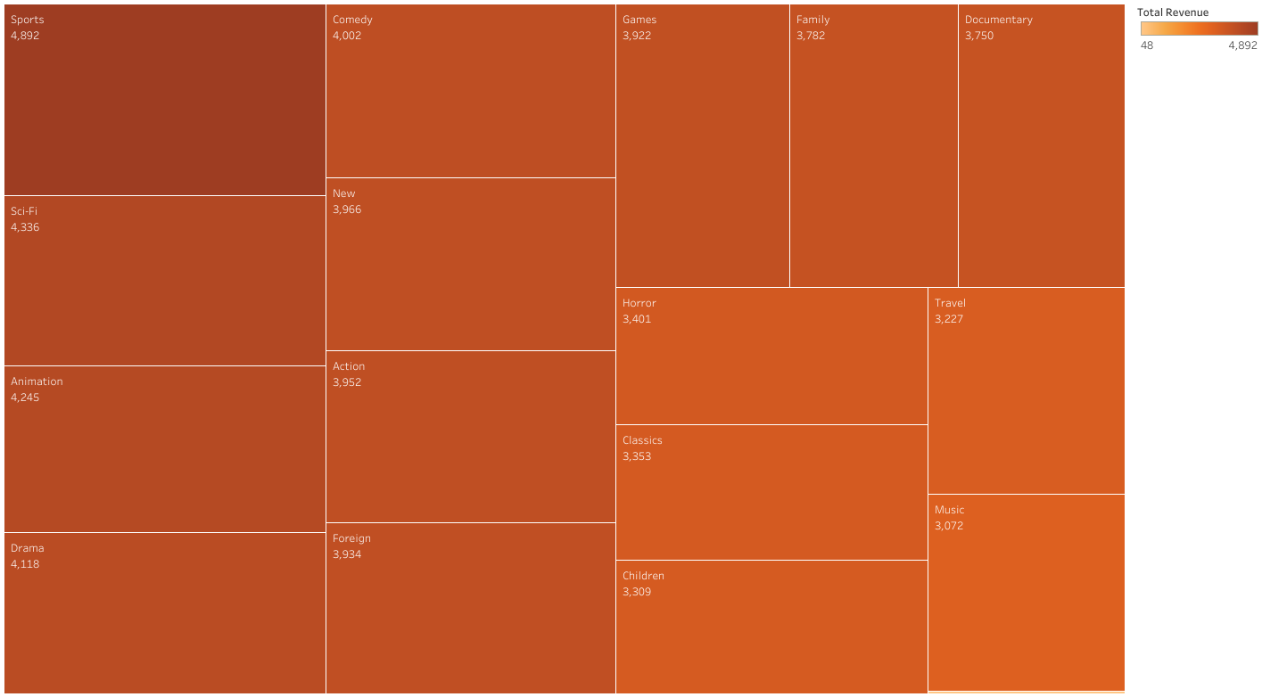
Chart
This chart shows the total revenue of each genre. The main revenue drivers by genre are Sports, Sci-Fi, Animation, Drama, and Comedy.

Slide 10
Main Takeaways
India and China are Rockbuster LLC’s most important market in terms of largest customer base and highest revenue.
The top 10 grossing movie titles are Telegraph Voyage, Zorro Ark, Wife Turn, Innocent Usual, Hustler Party, Saturday Lambs, Titans Jerk, Harry Idaho, Torque Bound, and Dogma Family.
The average rental duration is five days with a minimum of three days and a maximum of seven days.
The top five customers based on total amount paid are all located in one of the top ten countries by revenue.
The top two customers based on total amount paid are located in China and India respectively.
Sales figures vary widely based on geographic region.

Slide 11
Recommendations
Focus on our top two highest revenue earning countries. It would be beneficial for Rockbuster LLC to add more movies catered to these markets. For example, the highest-grossing film in China in 2023 is “The Battle at Lake Changjin”, it would be beneficial to add this to the online catalogue.
Thriller movies make up a disproportionate number movie titles (11 total) and total revenue ($48 total revenue), adding more thriller titles may open Rockbuster LLC up to a new market.
Add the top ten highest-grossing films to the online catalogue while omitting the ten lowest-grossing films.
Reward the top ten percent of customers with the most amount paid two weeks free of unlimited online rentals.

Slide 12

Thank You

